Slide 1
Call Centre Data Analysis on POWER BI Dashboard
Jitendra (2K22/DMBA/54)
Rama Shankar (2K22/DMBA/98)

Slide 2
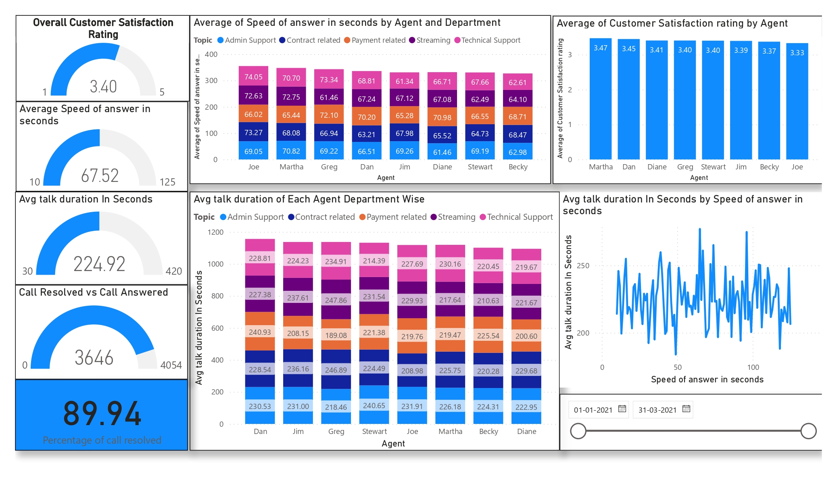
1.Overall Customer Satisfaction Rating- Shows total satisfaction rating of all customers 2. Average speed of answers in seconds: This gauge chart shows the average time it takes for each agent to answer a call. 3.Average talk duration in seconds: This gauge chart shows the average time each agent spends on each call with a customer. 4.Call resolved vs. call unresolved: This gauge chart shows the total number of calls answered by customers vs. the number of calls where the customer's query was resolved. 5.Average speed of answer in seconds by agent and department: This stacked chart shows the time it takes for each agent to answer a call, as well as the average time it takes for each agent in each department to answer a call. 6.Average customer satisfaction rating: This graph shows the average customer satisfaction rating for each agent. 7.Average talk duration of agent department-wise: This stacked chart shows the average time each agent spends resolving customer queries, broken down by department.

Slide 3
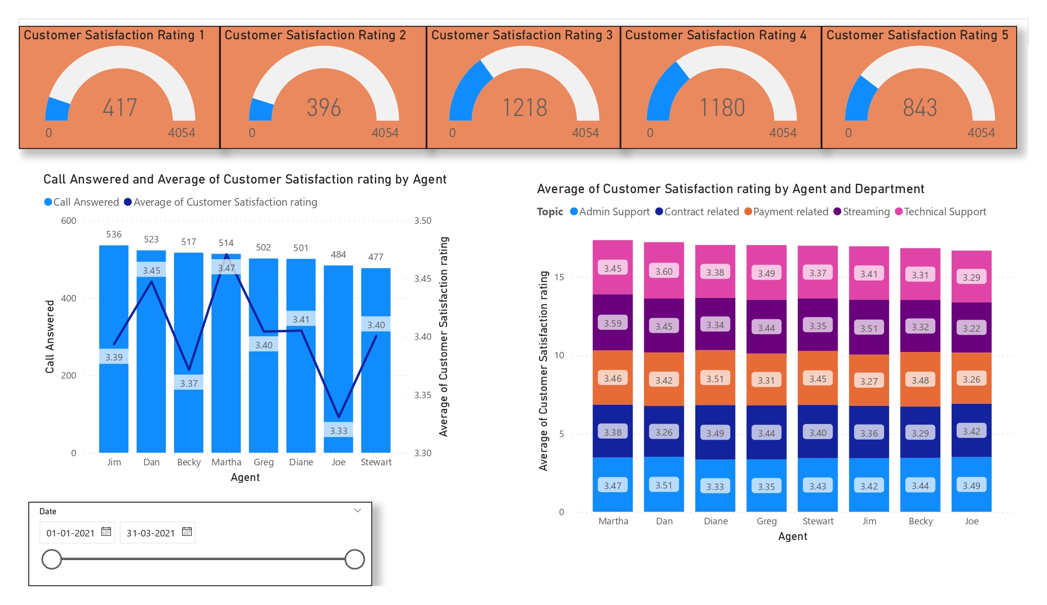
1.Customer Satisfaction Rating 1/2/3/4 /5 – These gauge charts tell about the how many customers give Customer Rating 1 to 5 They help Companies to Analyse to Focus more on which Customers .
2.Call Answered Average Customer Rating By Agent – By this stacked Chart we analyse is there any effect the customers who more call Answered on Customer Satisfaction Rating.
3.Average Customer Satisfaction Rating By Agent And Department- This Stacked Chart tell About Customer Satisfaction Rating Of Each Agent Department Wise BY help of this We Analyse the Problem in particular department queries and it also help us to Analyse agent wise efficiency of Call Department Wise.

Slide 4
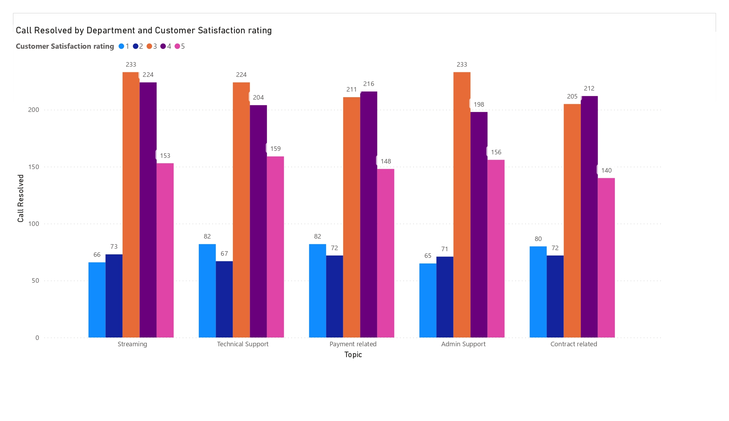
This graph shows how many calls were resolved in each department, categorized by customer satisfaction rating.

Slide 5
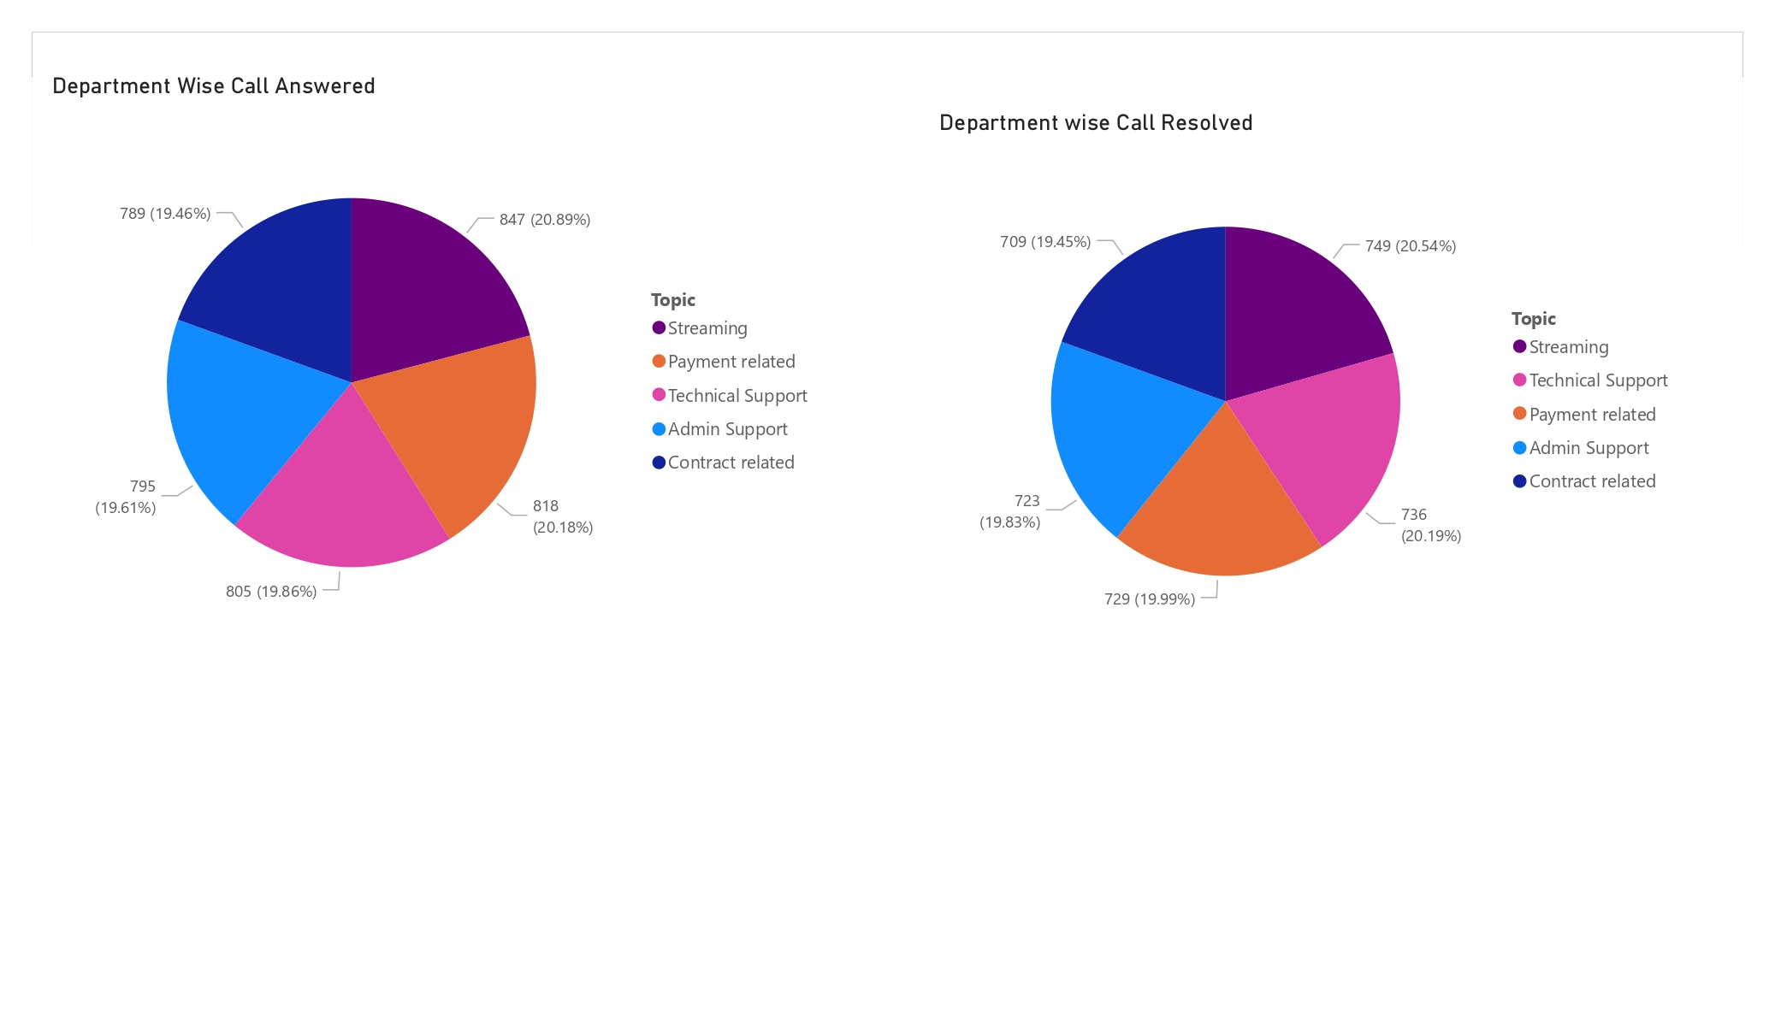
This Graph Shows Department Wise Call Answered in Each Department and another pie chart shows in out of total call answered How many Call Queries Resolved.

